Slide 1

Car Dealership
By Thwala TM, 218091161

Slide 2
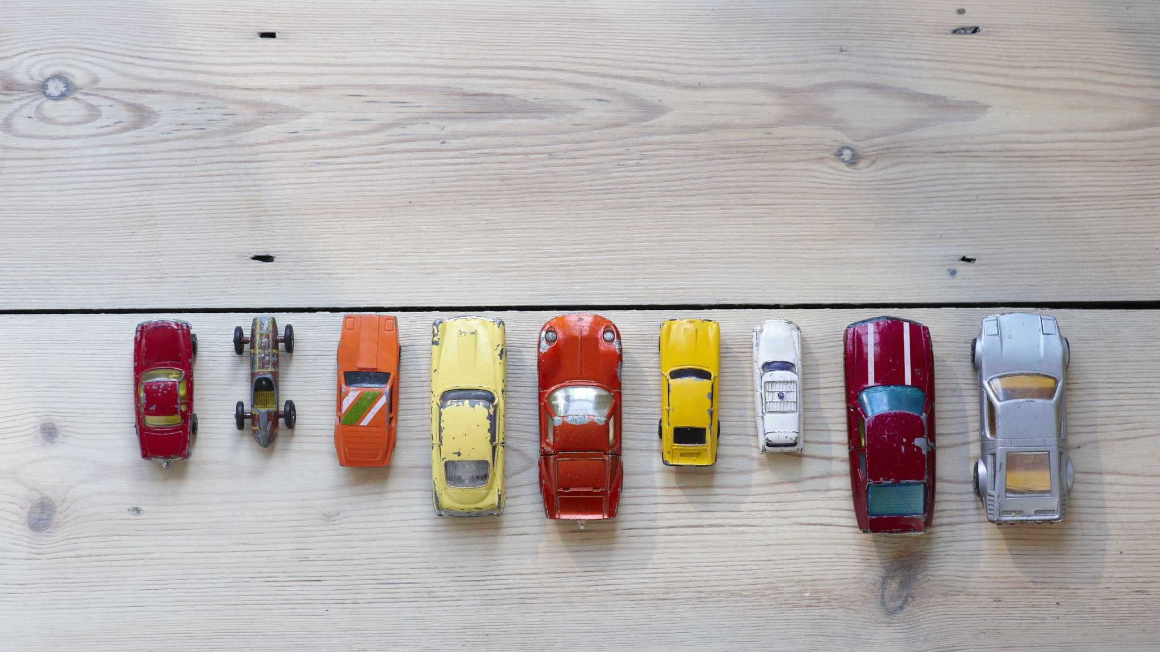
Problem
A local car dealership plans on buying second hand cars, some classics and others are fixer up. I was asked to assist by developing a software that will help model the different car shape.

Slide 3

Solution
I found a solution to this by drawing fast corners on an image of the cars. And added a feature to remove or convert the coloured picture to a black and white picture so there is little distortion on the shape of the cars.

Slide 4
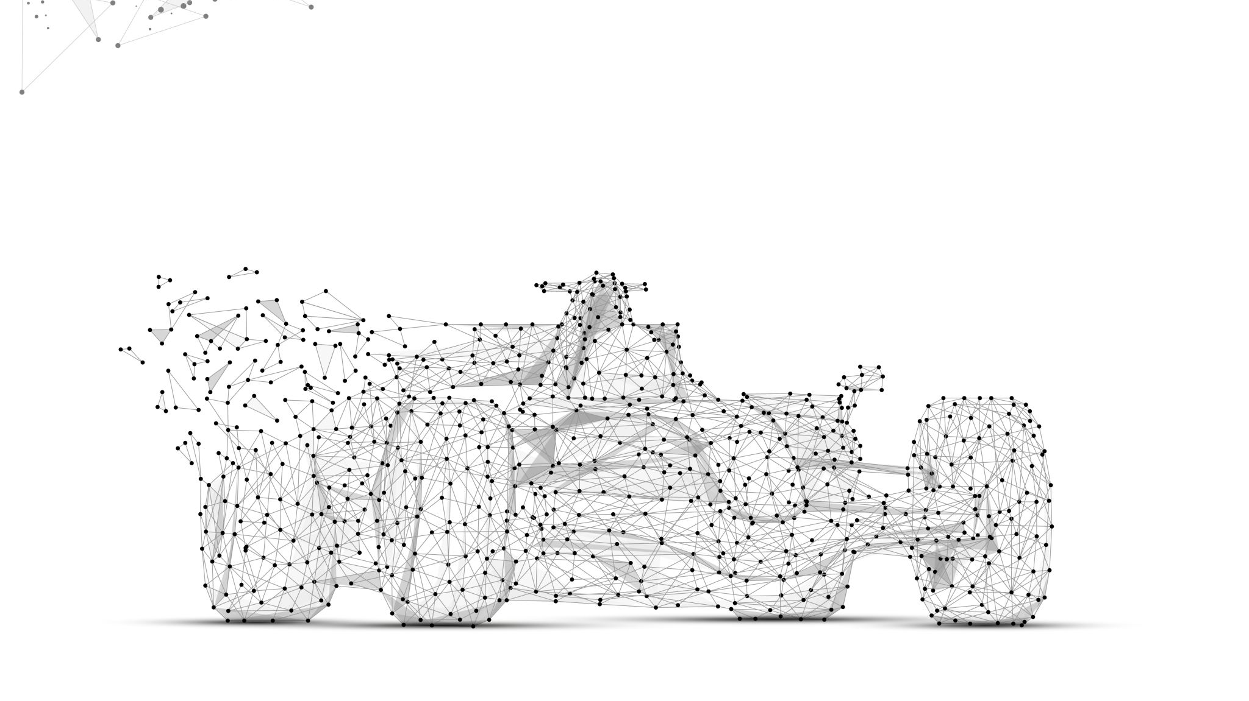
Methodology
The software uses grayscale; dilation or erosion as pre-processing functions. These functions are used to highlight features on the cars before feature extraction.
The software uses pictures stored on the system as different cars.
When a connection is established, the client can then extract features from different cars in the system.

Slide 5
Methodology
The fast feature values for the pre-processed sample pictures will be used for determining the classification ranges
When the client selects a picture, the software keeps track of the image files. This allows the client to use/ change from one pre-process to the next.

Slide 6

Samples of the cars
Classic cars in good condition.

Slide 7
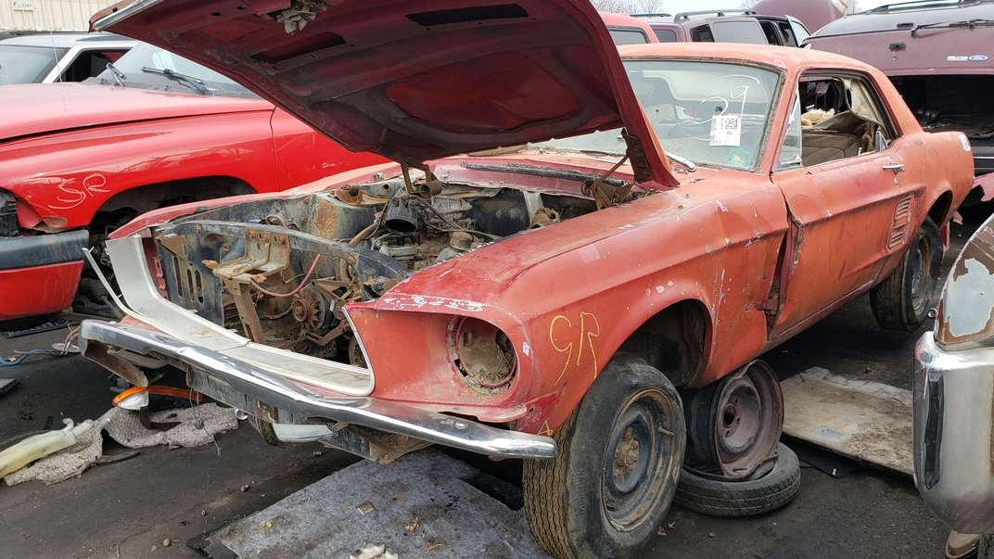
Samples of the cars
The fixer up cars, crashed cars.

